Slide 1
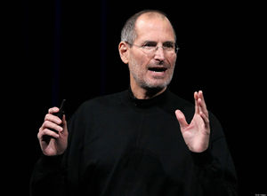



Foundations of Entrepreneurship
This Photo by Unknown author is licensed under CC BY-SA.
Entrepreneurial Qualities
Vision, Mission
Manoj K Mondal
RMSoEE, IIT Kharagpur
Lecture #6
Lecture Note # 05 (15.01.2021)
This Photo by Unknown author is licensed under CC BY.

Slide 2
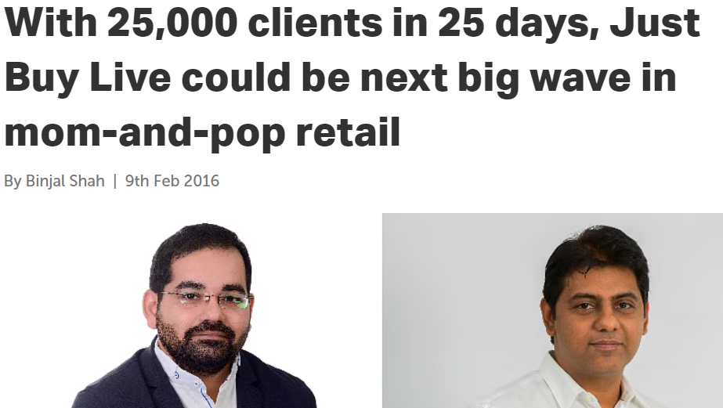
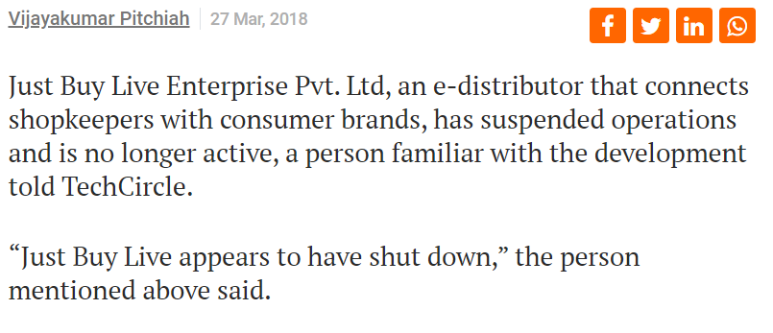
They appeared too good to fail but they failed too quickly

Slide 3
Topics of the Day
Successful entrepreneurs share some common traits.
Experts have identified some of these traits.
A team of members with complementary skills is necessary to succeed.
Many of the traits can be acquired.
Vision, Mission, and Values.
Google sheet for asking questions
https://docs.google.com/spreadsheets/d/11-hVC05i12zcpmq7kixjtxwaevDvrwM-A0SKe9fp260/edit?usp=sharing

Slide 4
Some entrepreneurs are extremely successful.
They seem to be successful in anything they start.
Whereas, there are others, who struggle to remain afloat.
While hard work is indispensable in entrepreneurship, but that is definitely not good enough.
Successful entrepreneurs have many common traits. They have the capability to identify opportunities in adversities. They take action with confidence, with optimism.

Slide 5
Various Sources have Listed Many Qualities of Successful Entrepreneurs. Here are some of the common ones. The list is incomprehensive, yet may appear intimidating by the sheer number. The good news is that not all of them are absolutely necessary and many of them can be acquired.

Slide 6
Qualities of Successful Entrepreneurs
Leadership qualities
People skill
Unique work style
Empathy
Financial savvy
Prior entrepreneurial exposure
Knowledge seeker
Strong peer network
Remain surrounded by great people
Tenacious
Tolerant to ambiguity
A positive view on constructive criticism
Readiness to delegate
Confidence
Disciplined and self-starters
They are open to new ideas

Slide 7
Qualities of Successful Entrepreneurs … cont’d.
Readiness to accept failure as an option and learn from every failure. Acknowledge mistakes and learn from them
Ability to sell
Frugal in their approach
The ability to manage money
They are reasonably passionate and know when to pivot and not driven by emotion
Self-motivated
They are systems thinker
An eye for opportunities in adversities

Slide 8
More Leadership qualities
Their honesty and Integrity are unquestionable.
They communicate effectively and can motivate all towards common goal.
They inspire others while taking responsibility and giving credit for good performance.
They set their mission, work passionately and are committed to achieve the goals.
They take the challenge head on and do not give excuses.

Slide 9
Leadership qualities … cont’d.
They educate, delegate and empower subordinates and help them grow and earn their trust and confidence, fostering an environment that proliferates such values through the team.
They try to be creative & Innovative and try to foster innovation.
They are prepared to face unexpected adversities/challenges/
They are charismatic.

Slide 10
Charisma
Cambridge Dictionary define charisma as - a special power that some people have naturally that makes them able to influence other people and attract their attention and admiration. How to acquire it?
They are self confident.
They are polite.
They are patient.
Keep their words.
Always have others’ best interest in mind.
Be experts in own field.
Honest, ethical, and above-board.
Not physically repulsive.
They seem real.
Listen twice as much as they talk.
Helpful, flexible and accommodative.

Slide 11
People Skill
Founders have to be able to communicate their vision to all the stakeholders including cofounders, employees, customers, suppliers, investors, even communities, (the whole ecosystem).
Their ability to lead, get people invested in their ideas, gain confidence, give them a sense of belongingness, motivate to give their best.
Success of a business rests on many pillars. Pillars are the people. One must communicate with confidence, give a sense of win-win and create an environment of optimism.

Slide 12
Elements of People Skill
Leadership
Persuasion
Influence
Network building
Ability to excite people by vision
Strong ethical and governance standard
Abide by the laws of the land and respect ownership of others.
Recreated from the book → Harvard Business Review: Entrepreneur's Handbook

Slide 13
Work Style
Goal oriented.
Comfortable with uncertainty.
Self-challenging.
Solitary: don’t like working for others; prefer being own boss.
Rarely satisfied or complacent; can’t sit still.
Driven to plan and be prepared.
Experimental mindset; ok with starting small and recognizing and moving past failures.
Perseverance in the face of adversity.
Tendency to continuously look for a better or different way to do things.
Ability to close a deal.
Inclination to listen, trust, take advice.
Recreated from the book - Harvard Business Review: Entrepreneur's Handbook

Slide 14
They are Empathetic to All Concerned
They strive to feel the pain that they aim to solve.
They engage with customers to understand how to match their expectations, what features would romance them and what are not appreciated.
They believe that customers are always right and the company must strive to satisfy them to remain and grow business.

Slide 15
They are Empathetic to All Concerned … cont’d.
They try to feel the pain of the employees by performing their tasks once in a while. In the process they learn the hardship and extraordinary efforts employees make to achieve company goals.
They try to align company objectives with those of the employees and make generous package so employees are happy at home. Happy people deliver better.
They make the employees feel as if the company belongs to them.

Slide 16
Empathizing the Customers
Empathizing with customers can never be overemphasized.
No matter how ground-breaking an idea or product is, unless a good number of customers pay profitable price in exchange for it, there is no business. Understanding the customers is central to leadership.
The hallmark of success for long-surviving companies is customer satisfaction and growing loyal & repeat customer base.

Slide 17
Financially Savvy
Comfortable with finance.
Have clear understanding of cash flow and its significance.
Understanding of the bottom-line, the burn rate or profit and how value is created.
Comfortable with financial governance.
Those who are incapable of managing money, surely fail in business. Poor fund management are frequently the cause of failure.

Slide 18
Internal Locus of Control
Entrepreneurs believe that they have the power over events in their lives.
They believe that they can create their future as they envision.
They do not believe in fate or blame outside forces for the outcome of their actions.
They may be spirituals but their thoughts on future are similar to those of the agnostic.
People with external locus of control tend to blame outside forces for all the failures and credit themselves for all the success.

Slide 19
Prior Entrepreneurial Exposure
Work experience in a start-up.
Close association with business of friends or family.
Corporate entrepreneurship.
Profit-center head.
Some experience of managing events.
Borrowing a phrase from a statement by Donald Rumsfeld, US Defense Secretary “… there are known knowns; there are things we know we know. We also know there are known unknowns; that is to say we know there are some things we do not know. But there are also unknown unknowns—the ones we don't know we don't know. …”
Notes:
Sonic attack by China, Cuba

Slide 20
Burning Desire for Learning: Knowledge-seeker
Business operation requires knowledge of many domains.
It may not be possible to be the best in everything.
But knowing more about many things is a clear advantage. One can have better perspective about many things and can lead better.
Successful entrepreneurs have constant passion for learning.
Obviously knowledge is pivotal for managing business and identifying opportunities.

Slide 21
They Understand the Value of a Strong Peer Network
In a competitive world, gaining success alone is a near impossible task.
Contacts with business partners, financial partners, strategic resources, technology partners, peer entrepreneurs, investors are invaluable.
At early stage of a technology start-ups one of the best assets is peer network with startups engaged in similar technologies.
Effective nurturing of the relationship with people who can help to troubleshoot many hurdles.
It has been propounded by many great leaders that one can constantly evolve stronger if surrounded by great people.
You are as good a leader as the people you keep company.

Slide 22
They are Tenacious
The tough competitive atmosphere of business demands unyielding, strong-willed and unfearful leaders.
These leaders meticulously plan ahead, adjust themselves quickly to changing scenarios, adapt to market responses.
Business at times has very high highs and very low lows. Expert entrepreneurs have the tenacity to absorb such shocks and capability to neutralize their impact on the organization.

Slide 23
They are Tolerant to Ambiguity and Uncertainties
Entrepreneurs sets goals and are committed and convicted to reach them. They also inspire others to follow them.
But, they should be open to unexpected developments and information and make mid-course corrections that mitigates adversities or better exploits the advantages.
Their readiness and ability to face both at once, in the face of great uncertainty, is the tolerance for ambiguity that sets an entrepreneur apart from the rest.

Slide 24
Readiness to Accept Failure as an Option and Learn from Every Failure, Acknowledge Mistakes and Learn from them
Entrepreneurs are often successful because they tend to comprehend the best possible course of action to get over the worst scenario.
However, they are mindful that things may not always manifest the best of ways and they are ready to accept failure.
They take lessons from failure to become stronger, smarter and invincible.
They do not sit back ruminating “what if”.
Almost all successful entrepreneurs mature through learning from failures and mistakes.

Slide 25
Ability to Sell
When a customer makes payment in exchange for a product or service in a profitable transaction, only then some business is done.
Ability to sell is highly essential to succeed in business.
Mark Cuban repeatedly emphasizes (in Shark Tank) that knowing how to sell is an absolutely essential part of being a successful business owner.

Slide 26
They are Frugal in their Approach
They recognize that there is always a lean way of doing things.
Frugality leads to faster execution, better economy, lesser risks, higher success possibilities, higher financial upside.

Slide 27
They are Reasonably Passionate and Know when to Pivot and not Driven by Emotion
They are circumspect and act with determination and work passionately to achieve the goal.
They continuously make assessment and have the capability to see the possible failure early on and pivot instead of persisting emotionally.
Jack Ma was rejected in 30 job applications and many college admissions.
Ma started business with determination. As a result, he could successfully launch Alibaba in 1999. In about 20 years, Alibaba is now valued nearly $500 billion.

Slide 28
They are Self-Motivated
Entrepreneurs do not wait for opportunities to find them.
They go out into the world and create solutions that make people happy.
They adapt to changes and carry their teams along, motivate them toward new goals and opportunities.

Slide 29
Readiness and Capability to Delegate
Entrepreneurs have too much to do. They should free their time and mind by delegating others. In the process they become more productive and bring in agility in the system.
It is not always necessary that they do everything the best.
They need to empower and train others to assume responsibilities.

Slide 30
Effective Time Management
Prioritize tasks.
Drop or delegate less important tasks to others.
Manage time effectively.
Know when to say ‘no’. People may demand their time, but frequently they may be addressed by others.

Slide 31
Seeking Help from Others
Many a times, we remain stuck in a line of thought, which is wrong.
Frequently, someone would easily point out the right course and success is achieved very quickly.
Being stubborn to do it ourselves, we deprive ourselves from achieving more than we do.
Technologies are changing too fast and it is almost impossible to know everything.
Help from others is synergistic.

Slide 32
Self-Discipline
Self-discipline is central to many of the traits mentioned above.
Self-discipline is self-control and is the key to success in business.

Slide 33
They are Systems Thinker
A business is a system consisting of many small components and it itself is a component of larger systems. Systems thinking is understanding the interrelationships between all components.
All components in a system interact, affect and promote each other in order for keeping a balanced progression. Disturbing one components can disrupt the whole system.
Systems thinking is a holistic approach that focuses on how a system's constituent parts interrelate and how it works within the context of larger systems.
Notes:
Mingers, J. (2015). Helping business schools engage with real problems: The contribution of critical realism and systems thinking. European Journal of Operational Research, 242(1), 316-331.
Systems thinking is the process of understanding how things influence one another within a whole. In nature,systems thinking examples include ecosystems in which various elements such as air, water, movement, plants, and animals work together to survive or perish.

Slide 34
Persistence and Perseverance
Persistence is the iron quality of character. Persistence is to the character of man as carbon is to steel. It is an indispensable quality that goes hand in hand with all great success in life.
Inculcating persistence: Tell your subconscious mind to be persistent.

Slide 35
Decisive And Action Oriented
They are decisive and they try many things.
They believe in actions and take corrective actions based validated learnings. They are open to new ideas and are not emotionally overly passionate.
The key to triumph is for you to try.

Slide 36
Circumspective & Confident
Entrepreneur have a 360 degree view about the business and always assess their strengths, weaknesses, opportunities and threats (SWOT) with changing macro situation.
They are confident in their actions and are not undecided.
They inspire others with their confidence in everything they do.

Slide 37
Best Promoter of the Business
They are Independent and would do whatever it takes to succeed.
They are the best spokesperson and promoter for their business.
Relationship-Builder: They have high social intelligence and an ability to build relationships that aid their firm’s growth.
They have strong determination and battle their way through difficult obstacles.
Source http://www.forbes.com/

Slide 38
Risk Takers
They take calculated risk. They have good instincts when it comes to opportunity identification and understanding the risk-return perspective.
They identify opportunities that are seemingly risky and achieve superior returns. Big rewards are associated with big risks.

Slide 39
The founding team should preferably consist of more than one members.
Ideally, members should possess complementary skills to balance the essential skill set.
They are self starter. Every successful entrepreneur are fully conscious of the fact that if something has to be initiated, it needs to be done by themselves.
So, aspiring entrepreneurs need to adopt these traits and make as many of them a part of their personality as possible to achieve success.

Slide 40
Values
Mission
Vision
Strategies
Execution
Vision
An enterprise is almost like a living being and all its stakeholders are its limbs.
To sustain and grow in the long run all its stakeholders need to share the same philosophies about its long-term goal, values that differentiate them from competitors and what its pride of place to be in the minds of customers and others.
The vision, mission, and values are usually recorded in statements providing direction to all stakeholders for everything that happens in an organization.

Slide 41
The Vision
Vision is where the company wants to be or what it aspires to accomplish in the long run.
It relates to the dream and passion.
Bill Gates envisioned to see personal computers in every home [and not really the progression of business].
One of Elon Musk's visions is to see humankind travel to Mars and live there. [But the design of the spacecraft is not part of that vision. But the vision guides the designs.]
Vision sets the direction for your business planning.
Founders have to be able to articulate and share a vision. A shared vision is one of the hallmarks of business success.

Slide 42
Vision: as defined in Business Dictionary
An aspirational description of what an organization would like to achieve or accomplish in the mid-term or long-term future. It is intended to serve as a clear guide for choosing current and future courses of action.

Slide 43
The Mission Statement
The mission in simple words is what a company does, the purpose for which it exists, who it serves and why customers should perceive it as different or preferable.
Mission statement explains its purpose(s) for being, defines its culture, values, ethics, and fundamental goals, and how these apply to its stakeholders.
This statement serves to plan and keep all stakeholders including employees focused on the tasks at hand.
It encourages the team to find innovative ways to achieve company goals.
A company’s stakeholders – employees, distributors, suppliers, investors, and partners – use this statement to align their goals with that of the company.

Slide 44
Mission Statement from the Business Dictionary
A written declaration of an organization's core purpose and focus that normally remains unchanged over time. Properly crafted mission statements (1) serve as filters to separate what is important from what is not, (2) clearly state which markets will be served and how, and (3) communicate a sense of intended direction to the entire organization.
A mission is different from a vision in that the former is the cause and the latter is the effect; a vision is something to be accomplished whereas a mission is something to be pursued for that accomplishment. Also called company mission, corporate mission, or corporate purpose.

Slide 45
Core Values
Core values are to support an organization's vision.
On a light note, it defines how the company behaves.
It shapes the culture and tradition in the company.
Employees strive to uphold the core values in all their transactions with all stakeholders.

Slide 46
Following are Some of Core Values:
Empathy
Quality
Ethics
Trust
Consistency
Conviction
Honesty
Accountability
Transparency
Confidence
Fair and impartial
Diversity
Passion
Imagination
Intelligence
Adventure
Growth
Safety
Tradition
Collaboration
Experience
Justice
Creativity
Action
Steadfastness

Slide 47
ITC
Vision
Sustain ITC's position as one of India's most valuable corporations through world class performance, creating growing value for the Indian economy and the Company's stakeholders.
Mission
To enhance the wealth generating capability of the enterprise in a globalising environment, delivering superior and sustainable stakeholder value.
https://www.itcportal.com/sustainability/sustainability-report-2006/html/itc-mission.aspx

Slide 48
ITC
Core Values
Trusteeship - stakeholder value
Customer Focus – Serve the customers increasingly better.
Respect for people – both within and outside the company.
Excellence – strive to excel in whatever we do.
Innovation – constantly innovate and challenge the status quo.
Nation oriented – broader value for the nation.
https://www.itcportal.com/sustainability/sustainability-report-2006/html/itc-mission.aspx

Slide 49
Company: Tesla
Mission: To accelerate the world’s transition to sustainable energy.
Vision: To create the most compelling car company of the 21st century by driving the world’s transition to electric vehicles.

Slide 50
Company: Amazon
Mission: We strive to offer our customers the lowest possible prices, the best available selection, and the utmost convenience.
Vision: To be Earth’s most customer-centric company, where customers can find and discover anything they might want to buy online.
Company: TED
Mission: Spread ideas.
Vision: We believe passionately in the power of ideas to change attitudes, lives and, ultimately, the world.

Slide 51
Company: Google
Mission: To organize the world’s information and make it universally accessible and useful.
Vision: To provide access to the world’s information in one click.

Slide 52
Company: Uber
Mission: Uber’s mission is to bring transportation — for everyone, everywhere.
Vision: Smarter transportation with fewer cars and greater access. Transportation that’s safer, cheaper, and more reliable; transportation that creates more job opportunities and higher incomes for drivers.
Company: AirBnB
Mission: Belong anywhere.
Vision: Tapping into the universal human yearning to belong—the desire to feel welcomed, respected, and appreciated for who you are, no matter where you might be.
Ericsson (a global provider of communications equipment, software, and services) defines its vision as being “the prime driver in an all-communicating world.”
Source: https://www.clearvoice.com

Slide 53
Mission Statements of Some Popular Companies
Adobe:“To move the web forward and give web designers and developers the best tools and services in the world.”
Paypal: “To build the Web’s most convenient, secure, cost-effective payment solution.”
Facebook: “To give people the power to share and make the world more open and connected.”
Intuit: “To improve its customers’ financial lives so profoundly, they couldn’t imagine going back to the old way.”
Kickstarter:“To help bring creative projects to life.”
LinkedIn: “To connect the world’s professionals to make them more productive and successful.”
Twitter: “To give everyone the power to create and share ideas and information instantly, without barriers.”
Tumblr: “To empower creators to make their best work and get it in front of the audience they deserve”
Alibaba: “To make it easy to do business anywhere.”

Slide 54
Vision Statement of Some Well-Known Companies
Google: To provide access to the world’s information in one click.
Toys R Us: Our vision is to put joy in kids’ hearts and a smile on parent’s faces.
Sony: “To be a company that inspires and fulfils your curiosity.”
Walmart: “We save people money so they can live better.”
L’Oreal: “Offering all women and men worldwide the best of cosmetics innovation in terms of quality, efficacy and safety”
WWF: We seek to save a planet, a world of life. Reconciling the needs of human beings and the needs of others that share the Earth
Charles Schwab: “Helping investors help themselves.”

Slide 55
Strategies, Goals, Objectives, Action Plans
Strategies – Strategies are actions to be taken to follow the mission statement so as to achieve the vision. Strategies are dynamically formulated based on changing environment.
Goals – are milestones that are to be achieved on a short term horizon. Strategies are implemented to achieve the goals.
Objectives – Objectives are related to the milestones with a specific timeline for achieving a goal. Set the objectives so you achieve the goal.
Action Plans – are plan of actions to achieve the goals and objectives.

Slide 56
You want to start an e-commerce company.
You target the niche market of hand-made goods.

Slide 57
Vision
Make sustainable efforts to ensure Indian artisans earn decent income.

Slide 58
Mission
To enhance the productivity, quality of products, reduce drudgery (improve health), and realize maximum value for goods and services of Indian artisans.

Slide 59
Core values Example: The e-commerce
We shall never compromise on the interest of the artisans.
We shall always endeavor to cut cost to maximize value for the artisans.
We shall do everything to face maximum price for goods.
Not charging more than 10% of the value of goods as commission.
Maintain absolute transparency.
Making no distinction between their money and our money.
Try to identify innovative solutions for our artisans to reduce their drudgery (ensure health), increase productivity, and improve quality in order for them to get the maximum value.
We shall always remain nation-oriented.

Slide 60
The Harvard Business Review Entrepreneur's Handbook: Everything You Need to Launch and Grow Your New Business - Harvard Business Review (2018)
Entrepreneurship – new Venture Creation by David H. Holt, Pearson (2016)
Entrepreneurship Simplified by Ashok Soota, Penguin Portfolio (2016)
http://www.forbes.com/
https://www.entrepreneur.com
https://www.thebalancesmb.com/vision-statement-2947999
https://www.employeeconnect.com
https://startupclass.samaltman.com/
www.businessdictionary.com/definition/vision-statement.html

Slide 61
Expert entrepreneurs have dreams. They are confident and optimistic to manifest them. They are disciplined self starters. They are patient and they persevere. They are open to new ideas those cross their path.
Success of a venture critically depends on many factors and entrepreneurial qualities are pivotal among them.
It is important to note that many of these traits can be learnt.

Slide 62
Conclusion:
Expert entrepreneurs have dreams. They are confident and optimistic to manifest them. They are disciplined self starters. They are patient and they persevere. They are open to new ideas those cross their path.
Success of a venture critically depends on many factors and entrepreneurial qualities are pivotal among them.
It is important to note that many of these traits can be learnt.

Slide 63
Thank you

